Slide 1

SEMINAR · BECE306P DIGITAL COMMUNICATION SYSTEMS
RF Fingerprinting for Physical-Layer Device Authentication
A survey of how radios are identified by their hardware imperfections, and a low-cost implementation on a 433 MHz ESP32 receiver
PRESENTED BY
Pratik Kumar (24BML0027) · Nikunj Goydani (24BEC0338)
Shruti (24BML0033) · Uday Krishan Khandelwal (24BML0017)
GUIDE
Dr. NandaKumar
SENSE, VIT
Notes:
This seminar surveys RF fingerprinting: identifying a radio from imperfections in its hardware rather than from its data. We cover the main families of published methods, compare them, find the gap, and in the last four slides show our implementation.

Slide 2
MOTIVATION
Authenticating the message is not authenticating the device
The problem
• Security usually checks a code or key carried in the data
• Cheap IoT links (433 MHz remotes, sensors) send fixed or weakly protected codes
• Anyone can record the signal and replay it with a $5 transmitter
• The receiver cannot tell the genuine radio from a copy
Known attacks
RollJam (Kamkar, DEF CON 2015): jams and records a rolling code, replays it later.
Garcia et al. (USENIX Security 2016): keyless entry of many vehicles broken by eavesdropping and cryptanalysis.
Idea: verify who transmitted from the radio hardware itself, not from the code it sends.
RF Fingerprinting · Seminar
2
Notes:
Most wireless security authenticates the data. Fixed codes can be recorded and replayed; RollJam and Garcia et al. show even rolling codes and car keys are vulnerable. Physical-layer authentication asks whether the signal came from the expected transmitter.

Slide 3
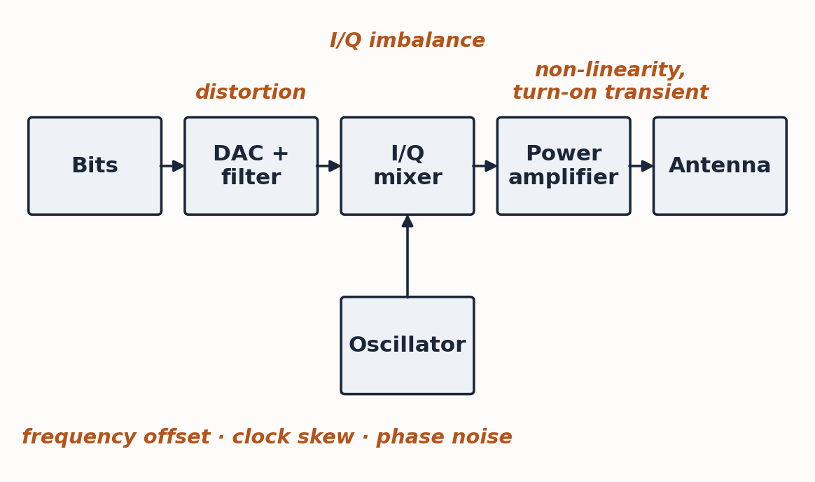
BACKGROUND
What is an RF fingerprint?
Small hardware imperfections, unique to each transmitter
• Oscillator frequency offset and clock skew
• Phase noise and timing jitter
• Amplifier non-linearity, turn-on transient
• I/Q imbalance and DC offset
• Filter and DAC distortion
From component tolerances: stable for one device, different across devices of the same model.
Transient-based: analyse the turn-on of a burst
Steady-state: analyse errors in the modulated part
RF Fingerprinting · Seminar · taxonomy after Danev, Zanetti & Čapkun, ACM Computing Surveys 2012
3
Notes:
Imperfections enter at every stage of the transmitter. Methods split into transient-based and steady-state families.

Slide 4
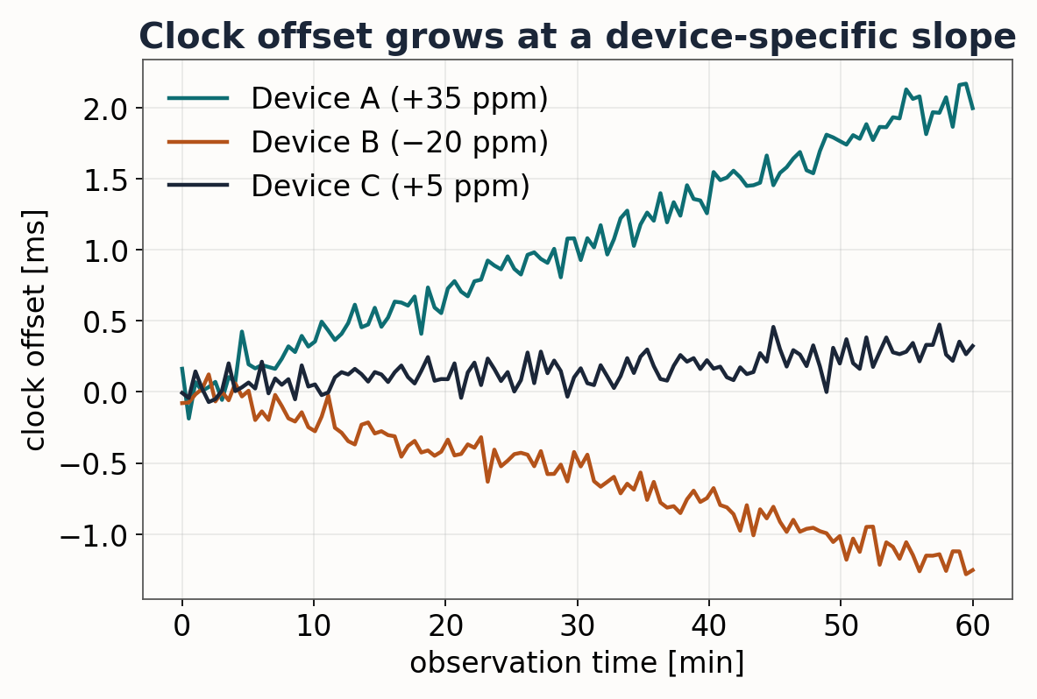
RELATED WORK · 1
Clock skew: every crystal ticks at its own rate
Kohno, Broido & Claffy · IEEE TDSC 2005
Remote physical device fingerprinting
• Clock skew from TCP timestamps
• Stable per device, measured remotely
Jana & Kasera · IEEE TMC 2010
Rogue access-point detection
• Skew from Wi-Fi beacon timestamps
• Catches an AP copying a real one
Takeaway: timing alone carries identity, but needs long observation.
RF Fingerprinting · Seminar
4
Notes:
Every crystal runs slightly fast or slow; the offset grows linearly and its slope identifies the device. Kohno used TCP timestamps; Jana and Kasera used Wi-Fi beacons to detect rogue access points.

Slide 5
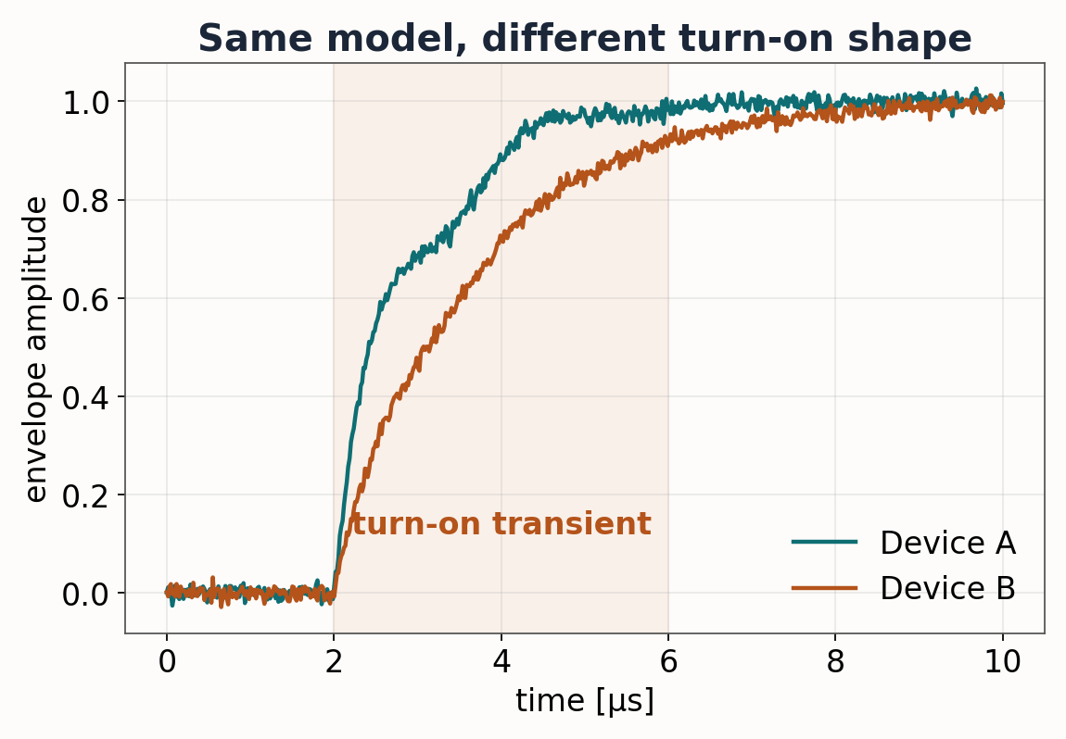
RELATED WORK · 2
Turn-on transients
Ureten & Serinken · Canadian J. ECE 2007
Wireless security through RF fingerprinting
• Find where the transient starts
• Classify its shape with a neural network
Danev & Čapkun · ACM/IEEE IPSN 2009
Identifying identical sensor nodes
• IEEE 802.15.4 nodes told apart
• High-rate oscilloscope in the lab
Limitation: microsecond transients need very fast sampling.
RF Fingerprinting · Seminar
5
Notes:
Transient methods look at the turn-on period before data starts. They separate even identical nodes but need very fast sampling.

Slide 6
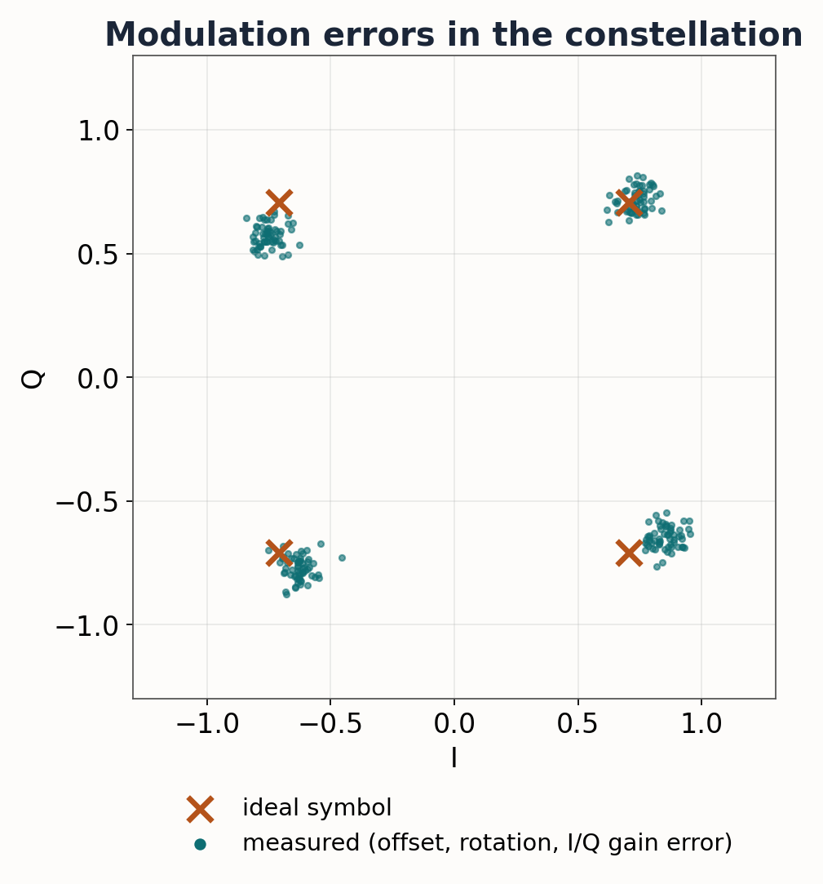
RELATED WORK · 3
Modulation errors: PARADIS
Brik, Banerjee, Gruteser & Oh · ACM MobiCom 2008
Radiometric signatures of 802.11b cards
• Frequency error, SYNC correlation, I/Q offset
• Magnitude and phase error
• k-NN and SVM classifiers
• Vector signal analyser for capture
Strength: whole frame. Limit: lab-grade equipment.
RF Fingerprinting · Seminar
6
Notes:
PARADIS measures modulation errors of 802.11b cards (offset, rotation, I/Q imbalance in the constellation) and classifies them with k-NN and SVM. Robust, but it needs a vector signal analyser.

Slide 7
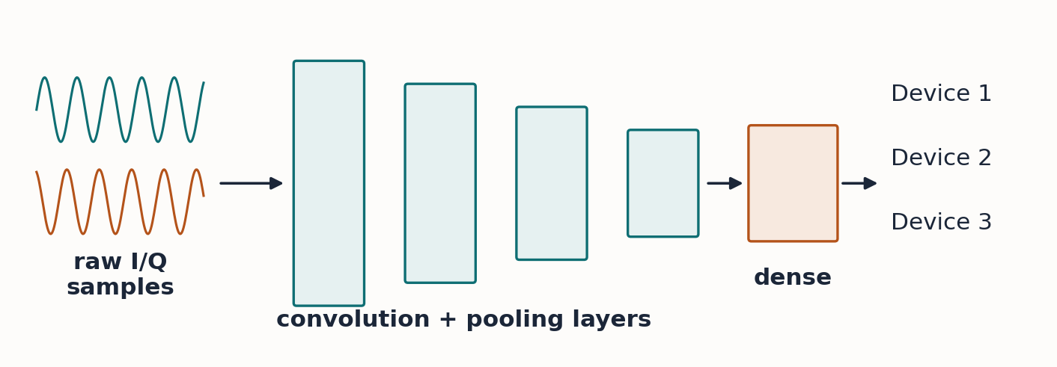
RELATED WORK · 4
Deep learning on raw I/Q samples
Merchant et al. · IEEE JSTSP 2018
CNN on the error signal of ZigBee devices
Riyaz et al. · IEEE Comm. Mag. 2018
CNN learns features from raw I/Q of SDR radios
Sankhe et al. · INFOCOM 2019 (ORACLE)
Same-model USRP radios; injected impairments help
Gain: no hand-made features; high accuracy
Cost: SDR, large models, GPU; channel-sensitive
RF Fingerprinting · Seminar
7
Notes:
From 2018 CNNs learned fingerprints directly from I/Q samples (Merchant, Riyaz, ORACLE). High accuracy, but they need SDRs and GPUs and are sensitive to the channel.

Slide 8
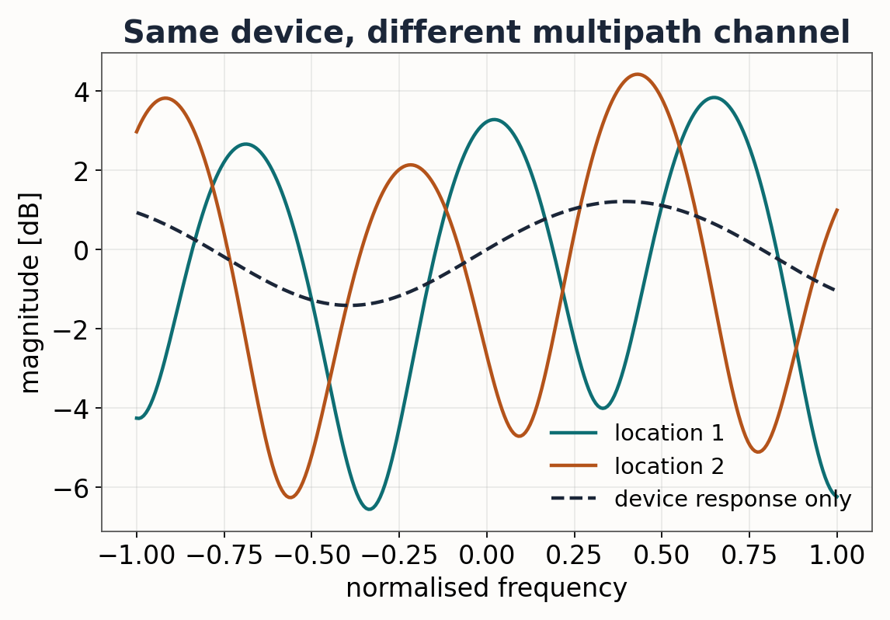
RELATED WORK · 5
The channel problem
Shen, Zhang, Marshall & Cavallaro · IEEE TIFS 2022
Channel-robust identification for LoRa
• Multipath can change the signal more than the device
• Channel-independent spectrogram
• Training with simulated channels
Lesson: features must separate the device from the channel and the receiver.
RF Fingerprinting · Seminar
8
Notes:
Multipath can dominate the device response; Shen et al. removed most of it with a channel-independent spectrogram. In our project the cheap receiver's own distortion plays the same role.

Slide 9
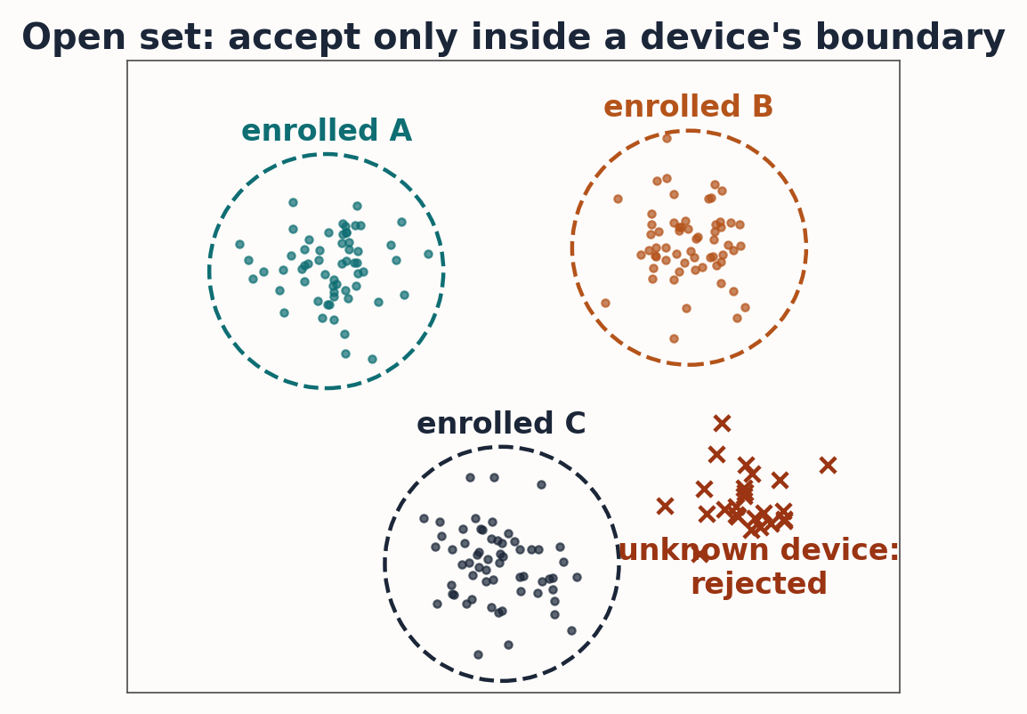
RELATED WORK · 6
Rejecting the unknown attacker
Schroff et al. CVPR 2015 · Hermans et al. 2017
Metric learning
• Triplet loss: same device close, others far
Lee et al. NeurIPS 2018 · Ledoit & Wolf 2004
Mahalanobis distance
• Distance to each enrolled device
• Reject beyond a threshold
Why: softmax always picks a known device, even for an attacker.
RF Fingerprinting · Seminar
9
Notes:
Closed-set classifiers label an attacker as some enrolled device; metric learning plus a Mahalanobis threshold per device rejects unknowns.

Slide 10
COMPARISON
The surveyed work side by side
Work | Capture | Feature and method | Limitation
Kohno 2005; Jana 2010 | Network timestamps | Clock skew | Long observation
Ureten 2007; Danev 2009 | High-rate oscilloscope | Turn-on transient | Very fast sampling
Brik 2008 (PARADIS) | Signal analyser | Modulation errors, k-NN / SVM | Lab equipment
Merchant, Riyaz 2018 | SDR I/Q | CNN | SDR and GPU
Sankhe 2019 (ORACLE) | USRP SDR | CNN, injected impairments | Costly testbed
Shen 2022 | SDR, LoRa | Channel-independent spectrogram | SDR required
Lee 2018 (ML) | Deep features | Mahalanobis open-set | Not RF-specific
RF Fingerprinting · Seminar
10
Notes:
Nearly every RF result depends on expensive capture hardware; the open-set methods are general, not RF-specific.

Slide 11
RESEARCH GAP
What the literature leaves open
01
Cost
Capture hardware costs far more than the device it protects.
02
Cheap receivers distort
Low-cost OOK receivers bias pulse widths; methods assume clean I/Q.
03
Not on the device
Decisions run on a PC or GPU, not on the receiver itself.
04
Single factor
The fingerprint is rarely combined with a user secret.
Question: can a $5 microcontroller behind a $1 receiver authenticate the transmitter on its own?
RF Fingerprinting · Seminar
11
Notes:
Four gaps: cost, receiver distortion, no on-device decision, single factor. That leads to our question.

Slide 12
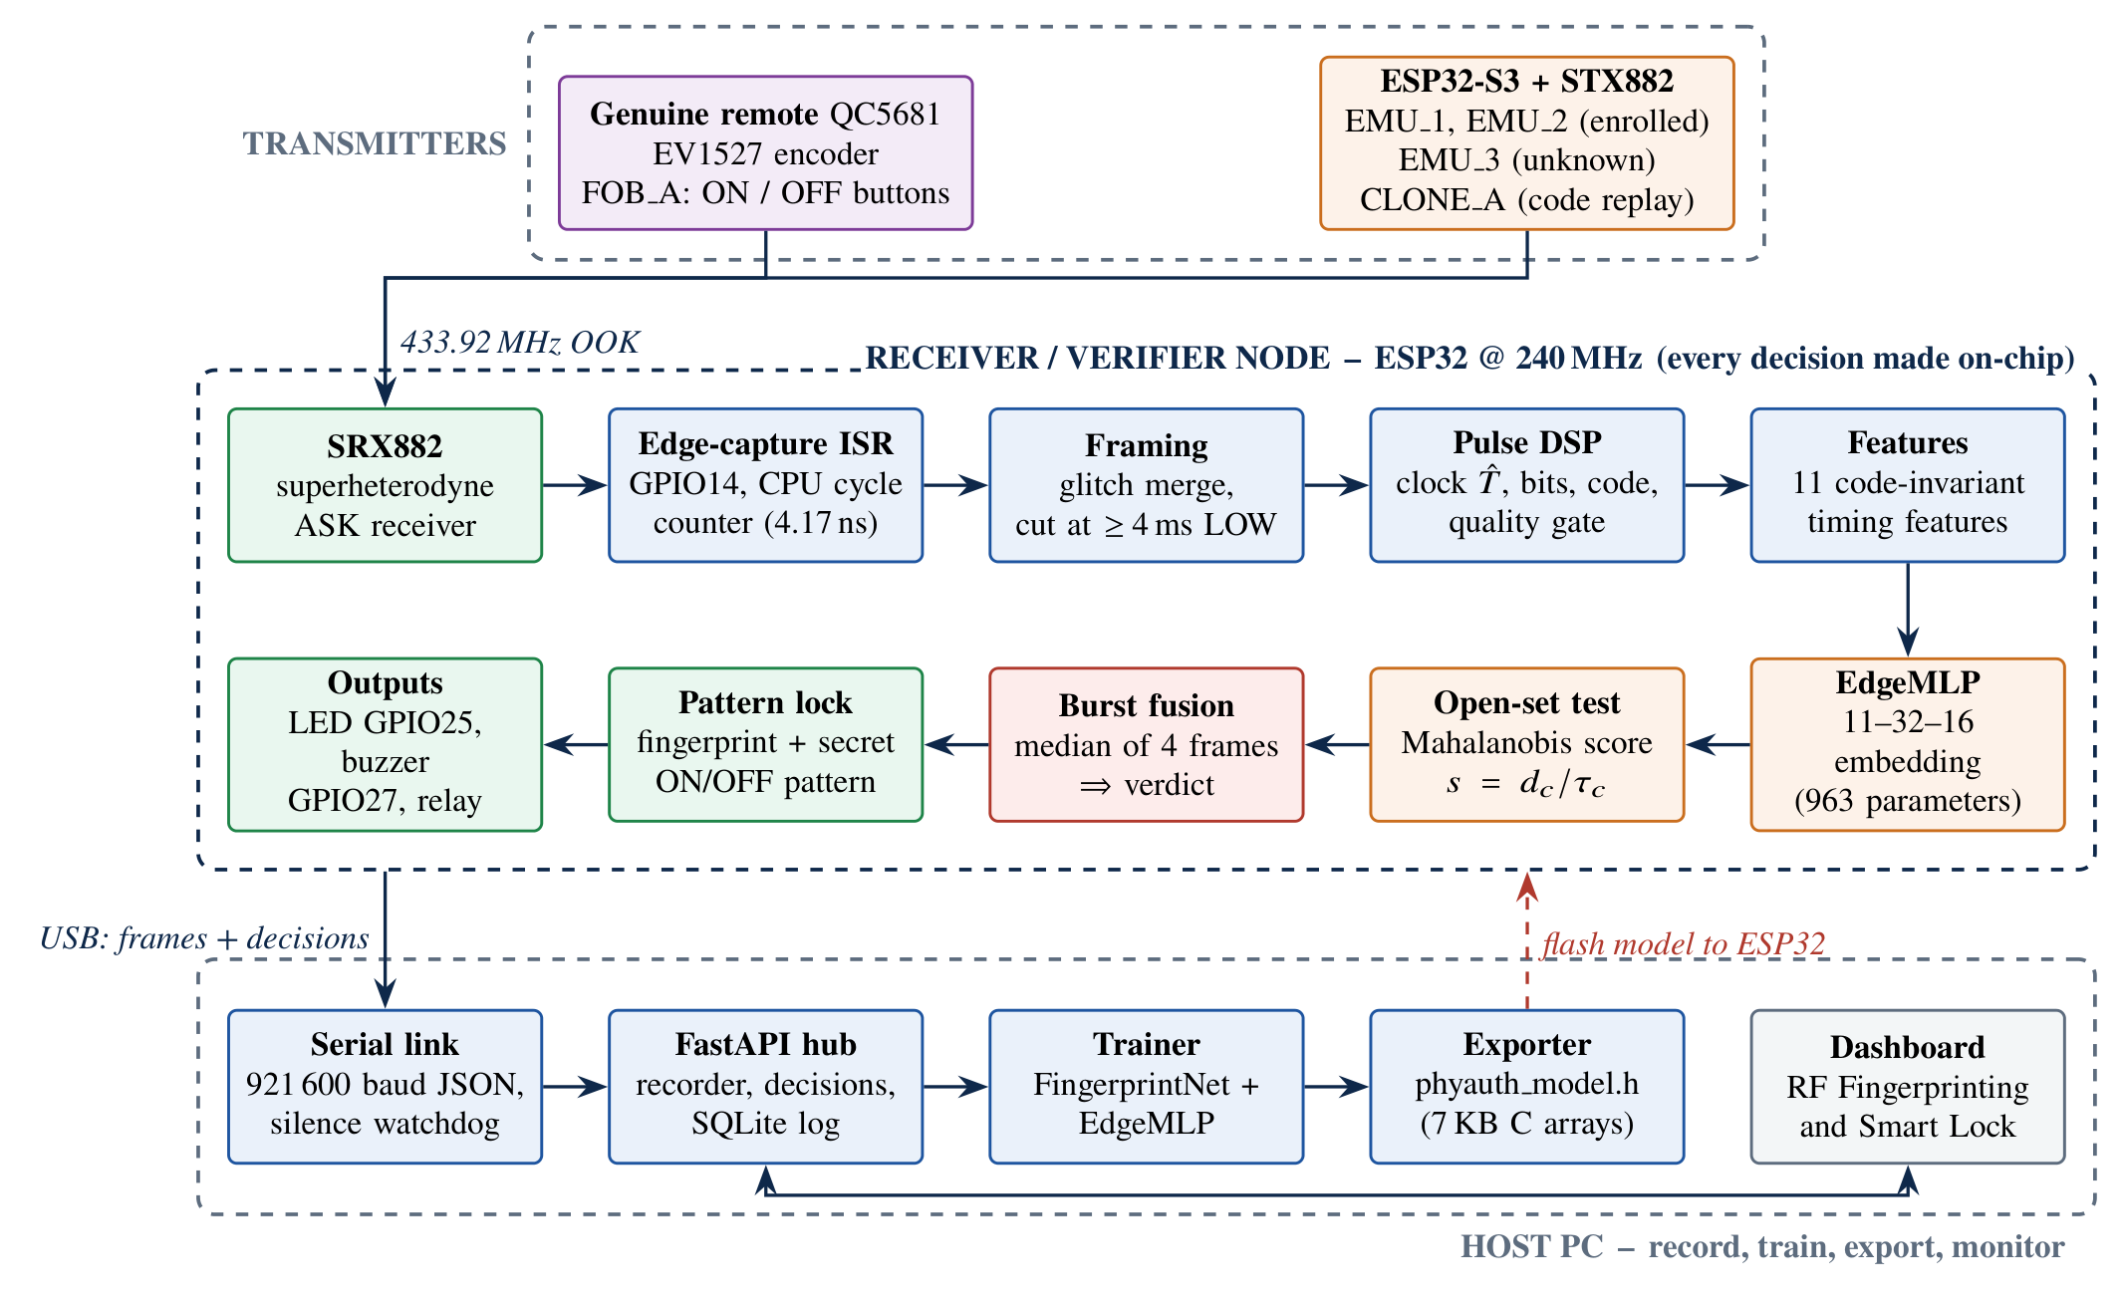
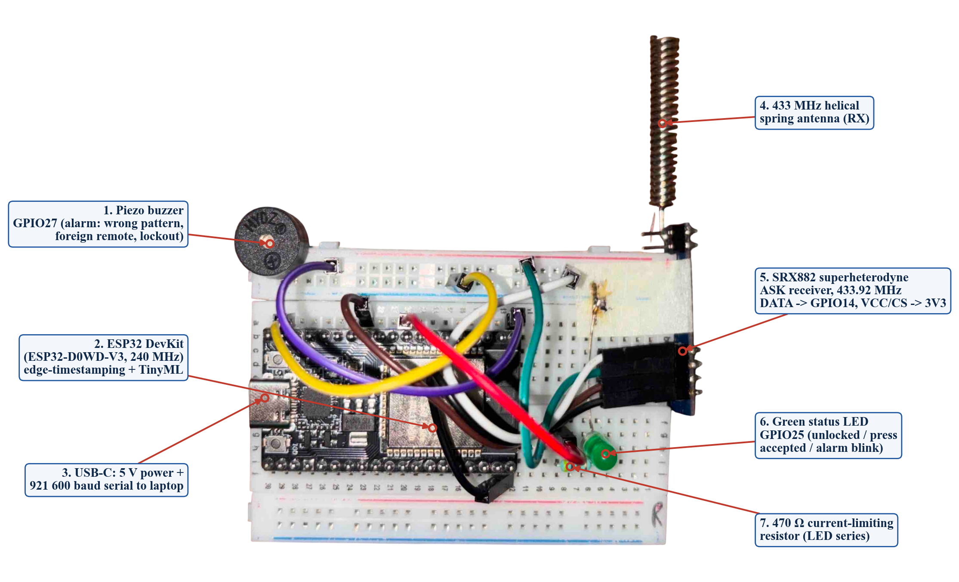
OUR WORK · PHYAUTH-RF
A 433 MHz fingerprint verifier on an ESP32
• Genuine: QC5681 EV1527 remote
• Receiver: ESP32 + SRX882 (≈ Rs. 650)
• Attacker: ESP32-S3 + STX882
• Every decision on the ESP32
RF Fingerprinting · Seminar
12
Notes:
PhyAuth-RF: a QC5681 remote, an ESP32 + SRX882 receiver, and an ESP32-S3 + STX882 emulator and attacker. All decisions are made on the ESP32; the laptop only trains and monitors.

Slide 13
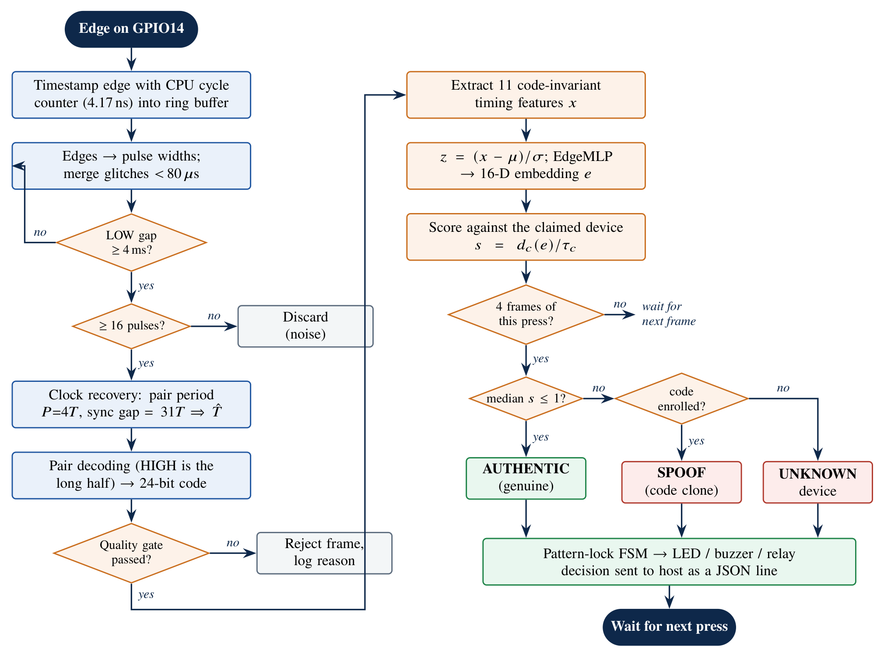
OUR WORK · METHOD
Timing fingerprints through a distorting receiver
4.17 ns edge timing
CPU cycle counter, no SDR or ADC
Distortion-proof clock
Pair period 4T + 31T sync cancel receiver bias
11 features → EdgeMLP
963 parameters, 7 KB on the chip
Open-set decision
Mahalanobis score; median of 4 frames ≤ 1
RF Fingerprinting · Seminar
13
Notes:
Edge timestamps at 4.17 ns; clock from the pair period and sync gap; 11 features into a 963-parameter EdgeMLP; Mahalanobis decision over four frames.

Slide 14
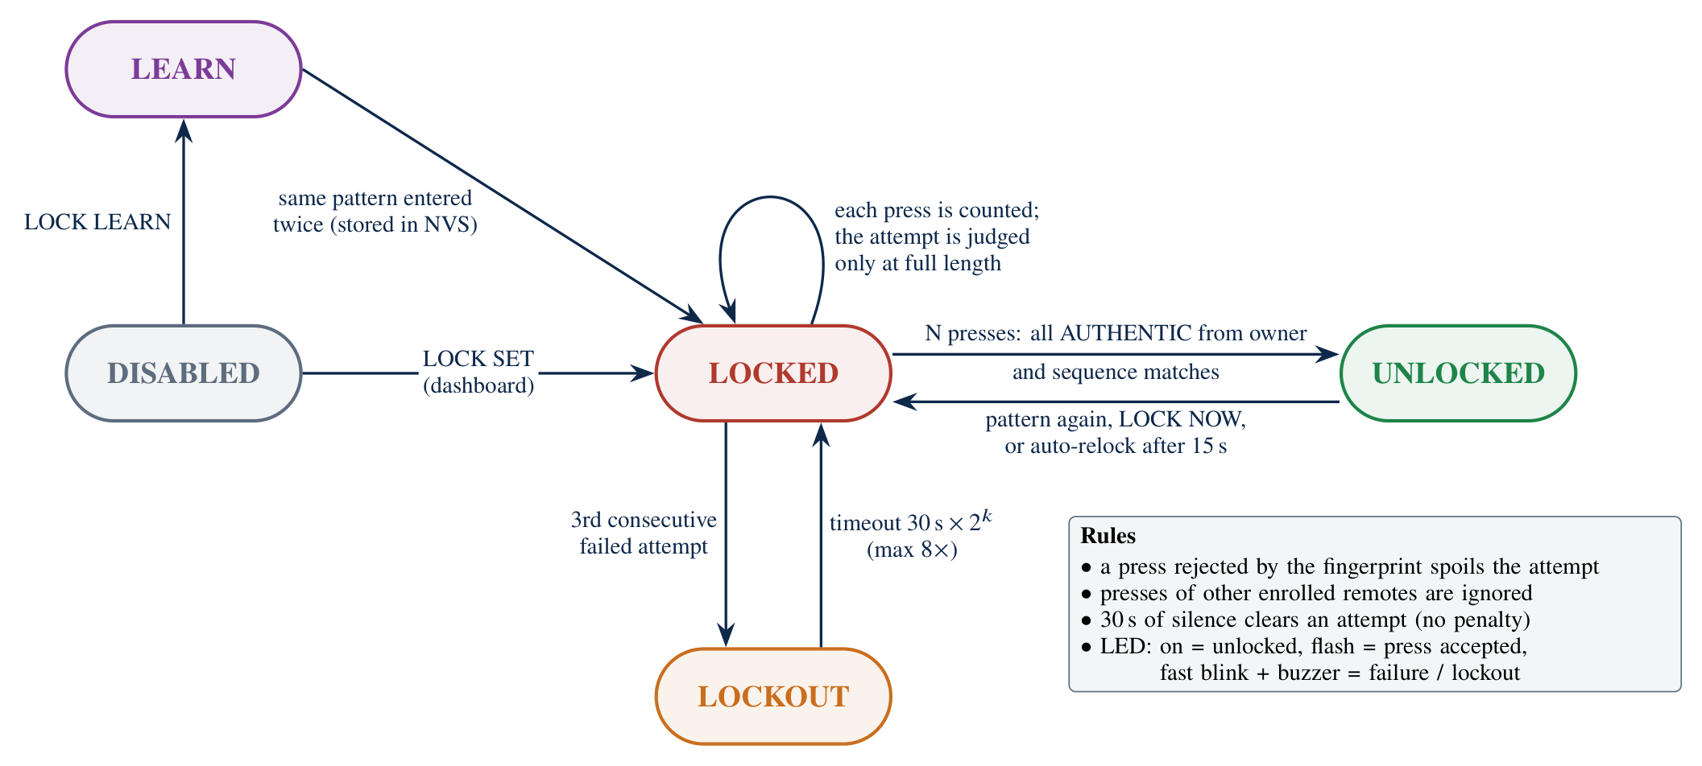
OUR WORK · RESULTS
Clones rejected, and a two-factor smart lock
100 %
closed-set accuracy
0.49 %
frame EER
30 / 30
clone bursts rejected
30 / 30
unknown bursts rejected
Two-factor smart lock
Opens only for the right remote (RF fingerprint) and the right ON/OFF pattern. A clone with the correct pattern still fails; 3 failures cause a lockout.
≈ 172 ms
decision time
7 KB
model on the ESP32
RF Fingerprinting · Seminar · held-out real captures
14
Notes:
100% accuracy, 0.49% frame EER, all clone and unknown bursts rejected, about 172 ms, 7 KB. Two-factor smart lock on the same ESP32. Limits: one genuine remote, small test sets, 0.75 to 1.25 m range.

Slide 15
CONCLUSION
From lab instruments to a $5 microcontroller
Key points
• Hardware imperfections identify a transmitter beyond its data
• Research moved from clock skew and transients to deep learning on SDR I/Q
• Open problems: cost, channel and receiver effects, unknown attackers
• PhyAuth-RF runs a timing fingerprint on-chip at low cost
References
Kohno et al., IEEE TDSC 2005
Jana & Kasera, IEEE TMC 2010
Ureten & Serinken, Can. J. ECE 2007
Danev & Čapkun, IPSN 2009
Brik et al., ACM MobiCom 2008
Danev et al., ACM Comput. Surv. 2012
Merchant et al., IEEE JSTSP 2018
Riyaz et al., IEEE Commun. Mag. 2018
Sankhe et al., IEEE INFOCOM 2019
Shen et al., IEEE TIFS 2022
Schroff et al., CVPR 2015; Lee et al., NeurIPS 2018
Garcia et al., USENIX Security 2016
Thank you. Questions?
RF Fingerprinting · Seminar
15
Notes:
Summary and thanks.

